Slide 1


Spring 2021
SKKU Biostats and Big data
CHOONG-WAN WOO | COCOAN lab | http://cocoanlab.github.io

Slide 2
GBME Probability and Statistics | Spring 2021
Lecture 01
Lecture 01
Course overview, Statistics?
CHOONG-WAN WOO | COCOAN lab | http://cocoanlab.github.io

Slide 3

Lecture 01
Introduction
Lab webpage
https://cocoanlab.github.io/
CHOONG-WAN WOO | COCOAN lab | http://cocoanlab.github.io

Slide 4
Lecture 01
Course overview
Biostats and Big data (previously GBME’s Probability and Statistics)
Class code: GBE 3064 (Previously GBE 3037)
Intro Stats
Textbook: "Stats: Data and Models" by De Veaux, Velleman, and Bock, Fourth Edition
Third edition also works!
CHOONG-WAN WOO | COCOAN lab | http://cocoanlab.github.io

Slide 5
Lecture 01
Course overview
Biostats and Big data (previously GBME’s Probability and Statistics)
Class code: GBE 3064 (Previously GBE 3037)
Intro Stats
Textbook: "Stats: Data and Models" by De Veaux, Velleman, and Bock, Fourth Edition
Third edition also works!
And also I’m writing a textbook in Korean.. Maybe coming soon.. I will share some of them.
Two useful web-based platforms for the class:
Slack for class-related discussion and questions
GitHub for posting class-related materials, assignments, data, codes, etc
CHOONG-WAN WOO | COCOAN lab | http://cocoanlab.github.io

Slide 6
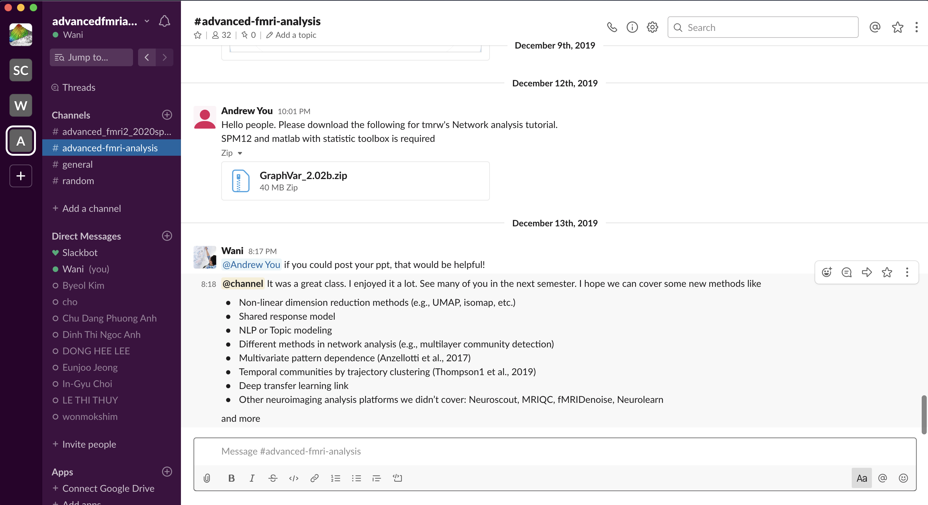
Lecture 01
A great platform for team communications
I will share the link for the class during the first week of the class (you should join)
Works for both desktop and mobile phone
Real examples
CHOONG-WAN WOO | COCOAN lab | http://cocoanlab.github.io

Slide 7
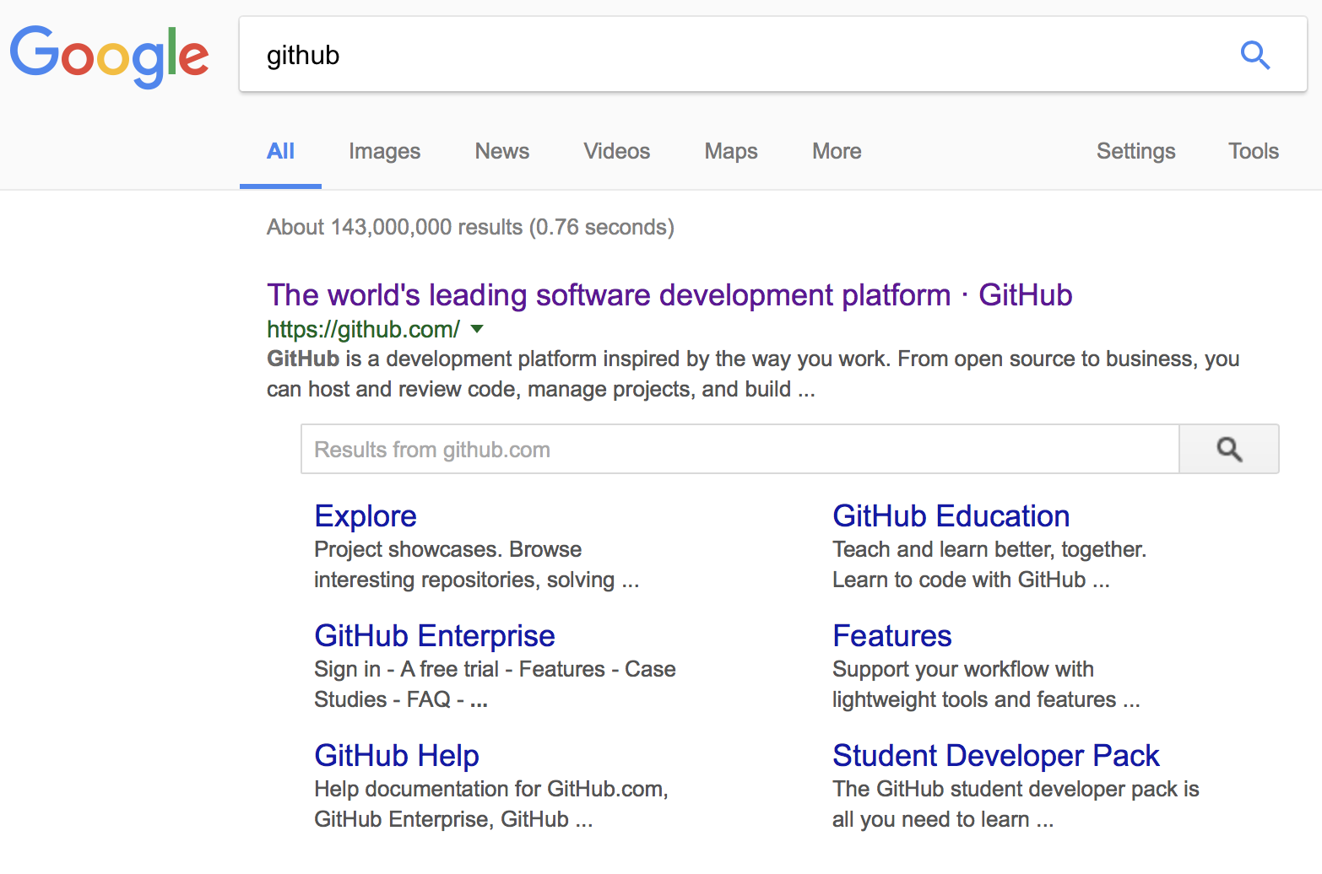
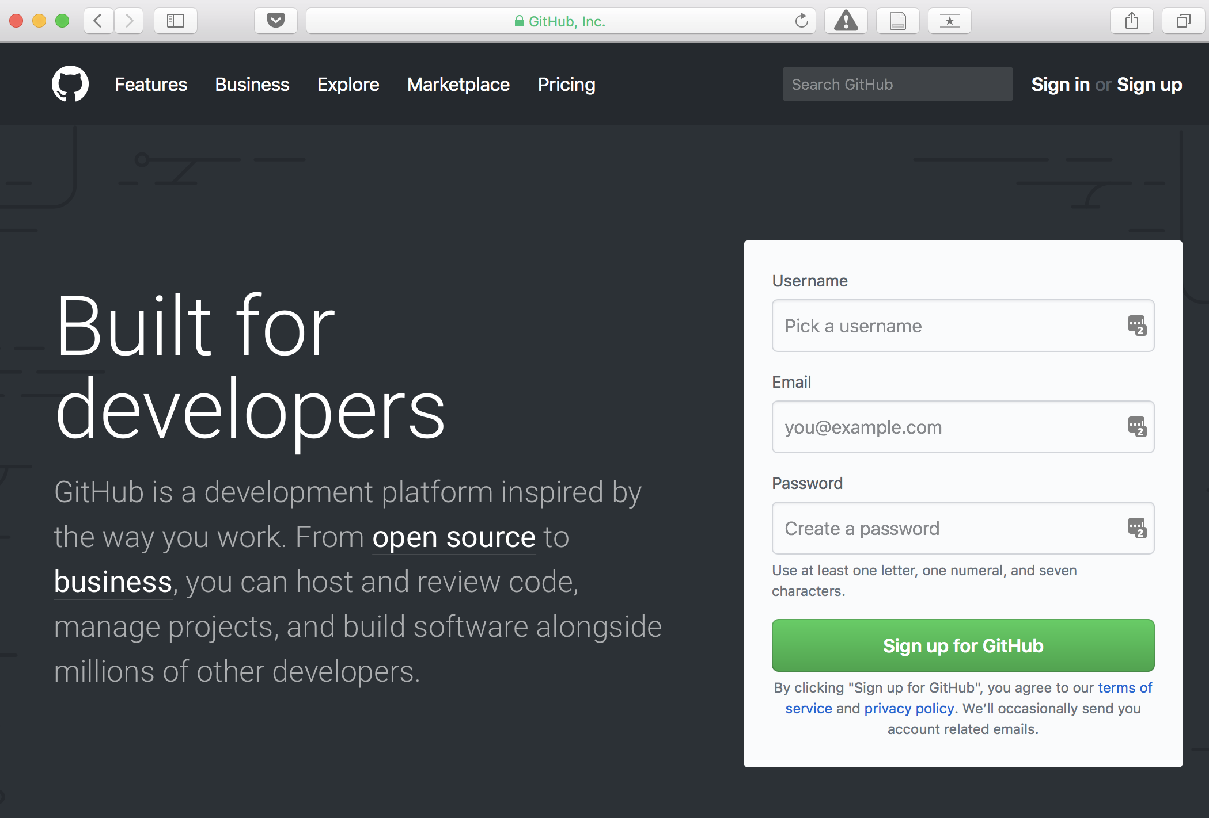
Lecture 01
Most popular software development platform: version control, easy-sharing scripts and data, etc.
CHOONG-WAN WOO | COCOAN lab | http://cocoanlab.github.io

Slide 8
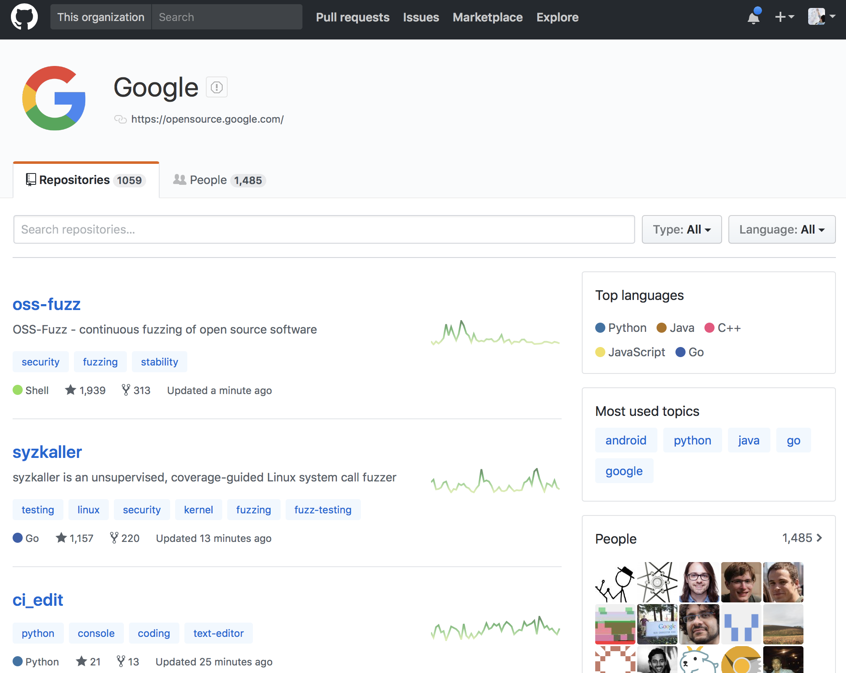
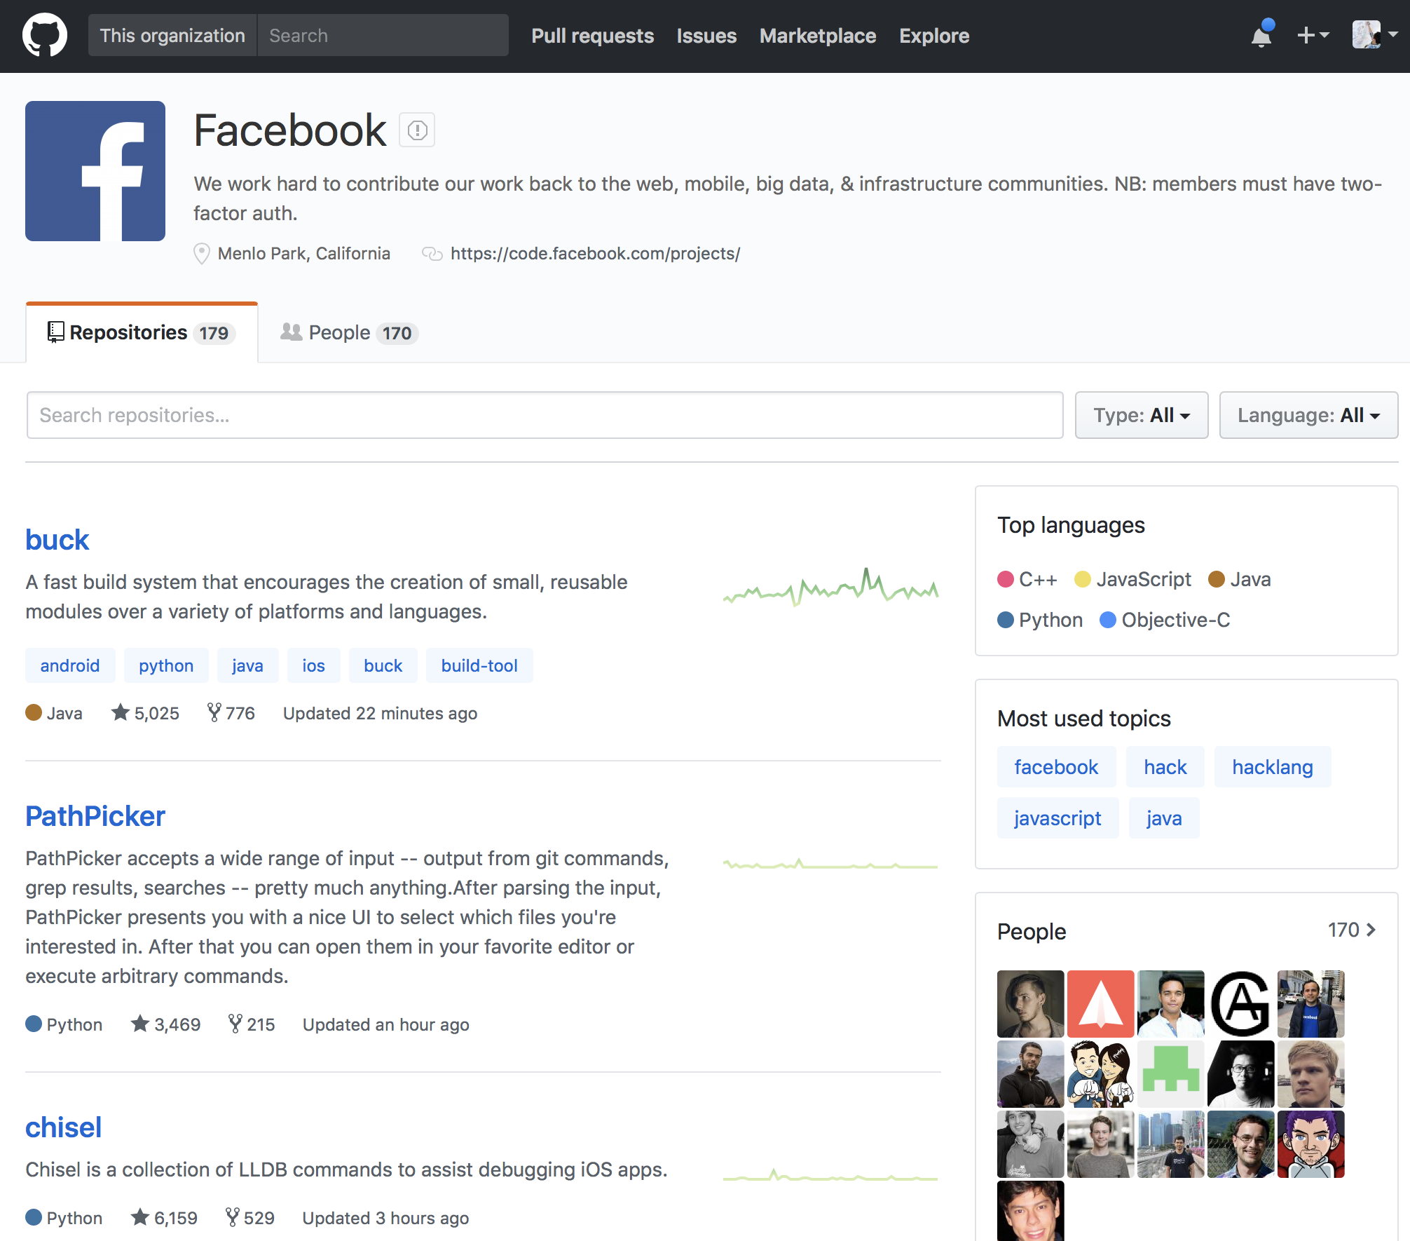
Lecture 01
Most popular software development platform: version control, easy-sharing scripts and data, etc.
Everyone uses GitHub for the development, including Google, Facebook, etc.
CHOONG-WAN WOO | COCOAN lab | http://cocoanlab.github.io

Slide 9
Lecture 01
Most popular software development platform: version control, easy-sharing scripts and data, etc.
Everyone uses GitHub for the development, including Google, Facebook, etc.
More and more people are creating and sharing a GitHub repository for their research and publications:
CHOONG-WAN WOO | COCOAN lab | http://cocoanlab.github.io

Slide 10
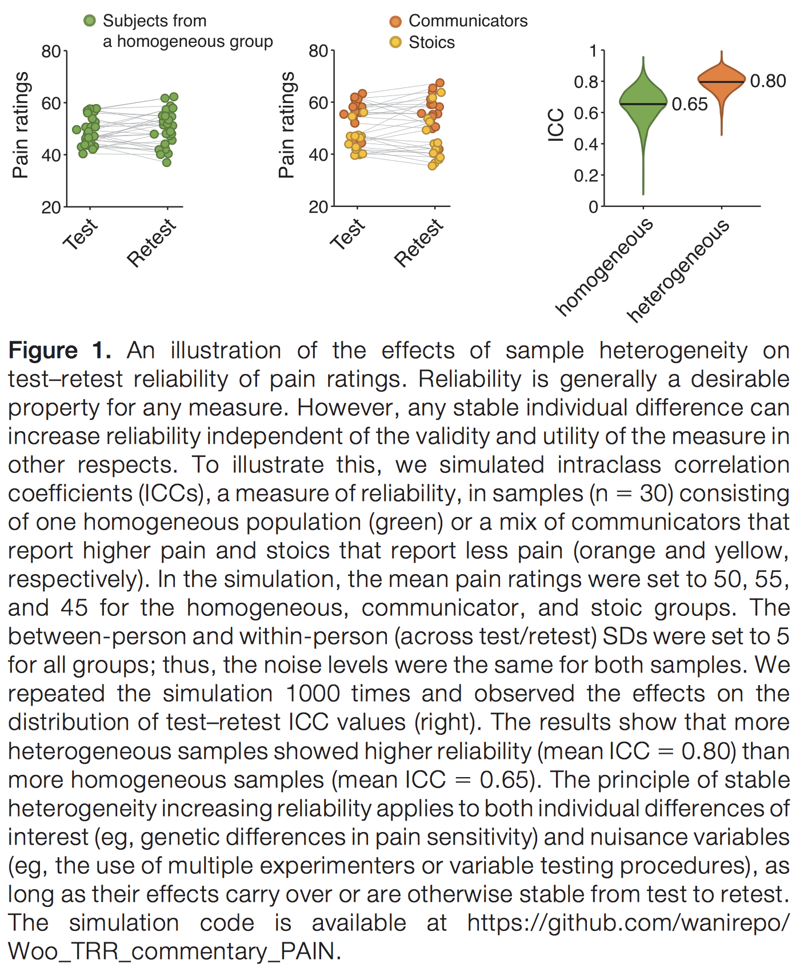
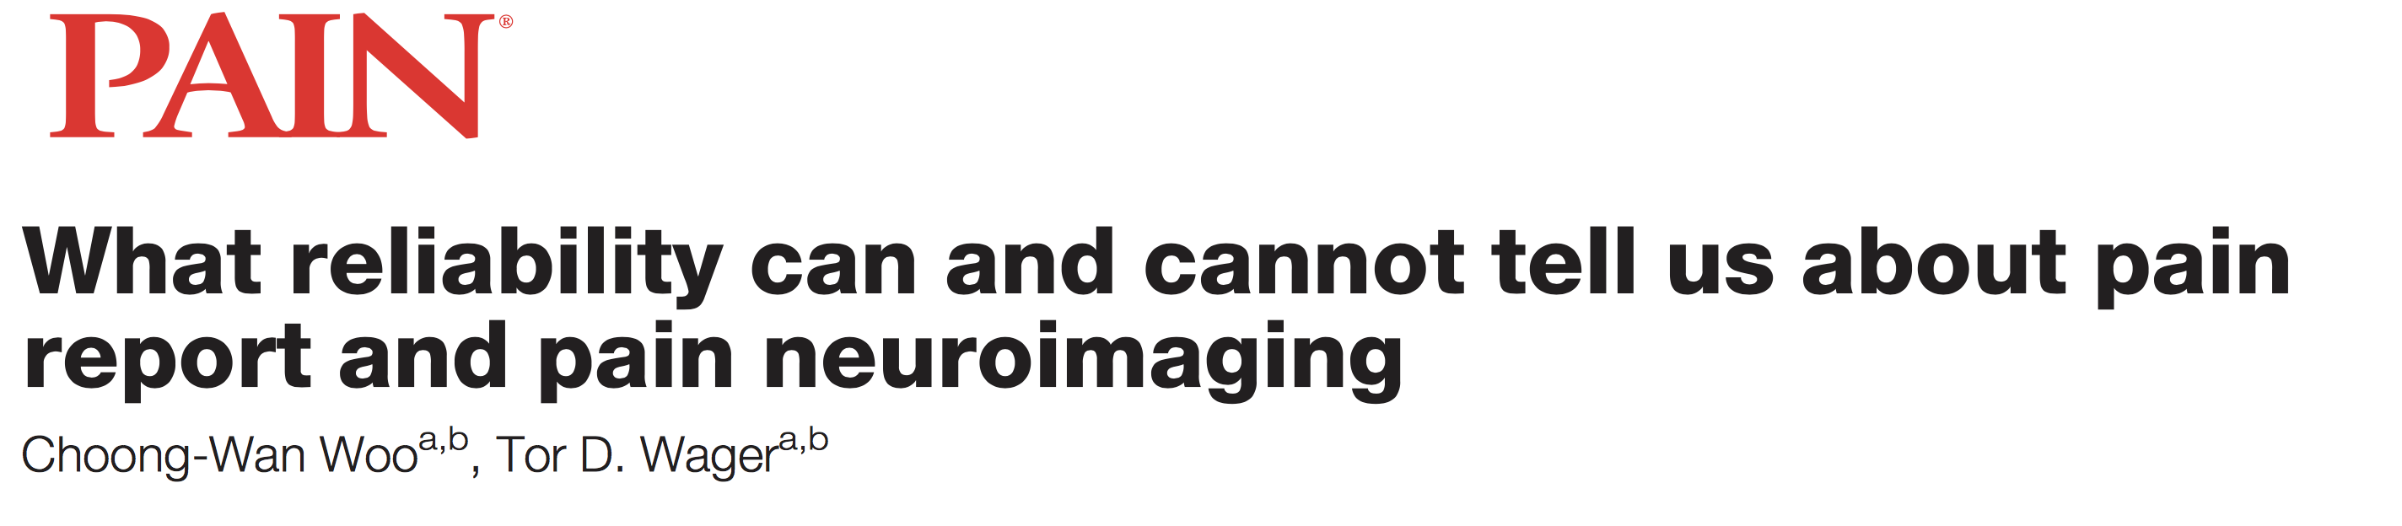
Lecture 01
Most popular software development platform: version control, easy-sharing scripts and data, etc.
Everyone uses GitHub for the development, including Google, Facebook, etc.
More and more people are creating and sharing a GitHub repository for their research and publications:
E.g., Woo & Wager, 2016, PAIN
CHOONG-WAN WOO | COCOAN lab | http://cocoanlab.github.io

Slide 11
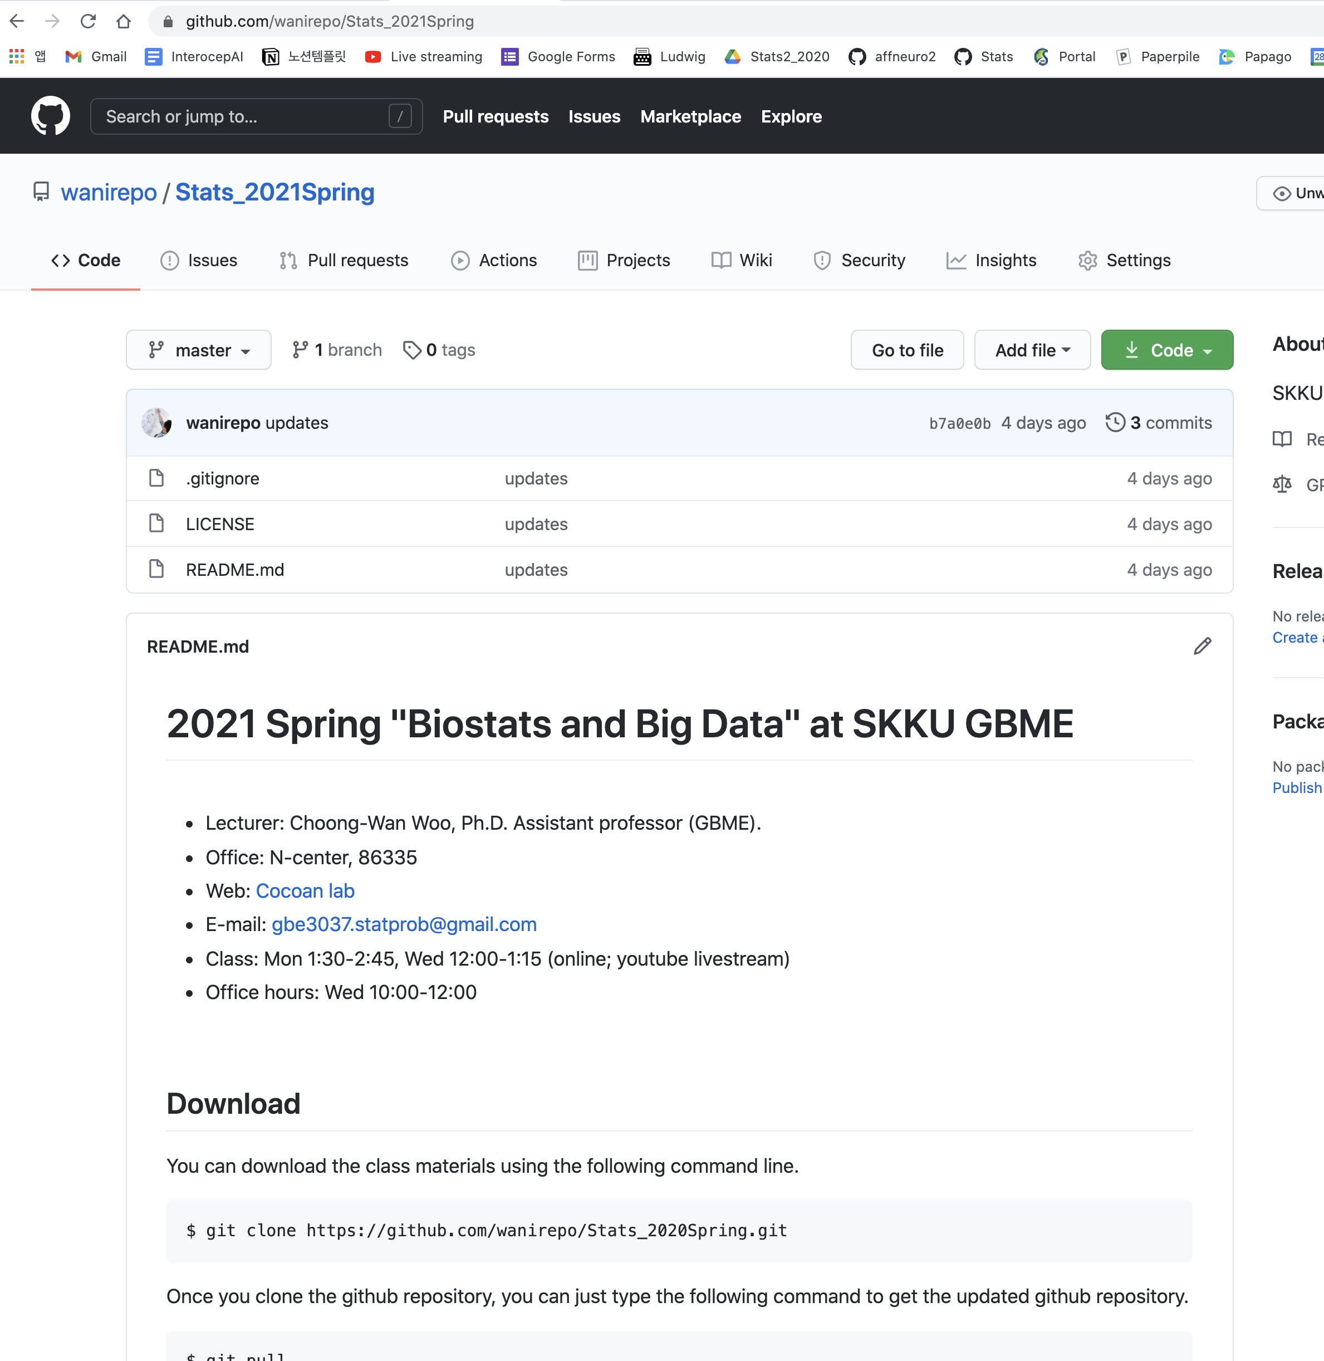
Lecture 01
Our class website: https://github.com/wanirepo/Stats_2021Spring
README.md is the syllabus.
Let’s visit the website and read the syllabus together.
CHOONG-WAN WOO | COCOAN lab | http://cocoanlab.github.io

Slide 12
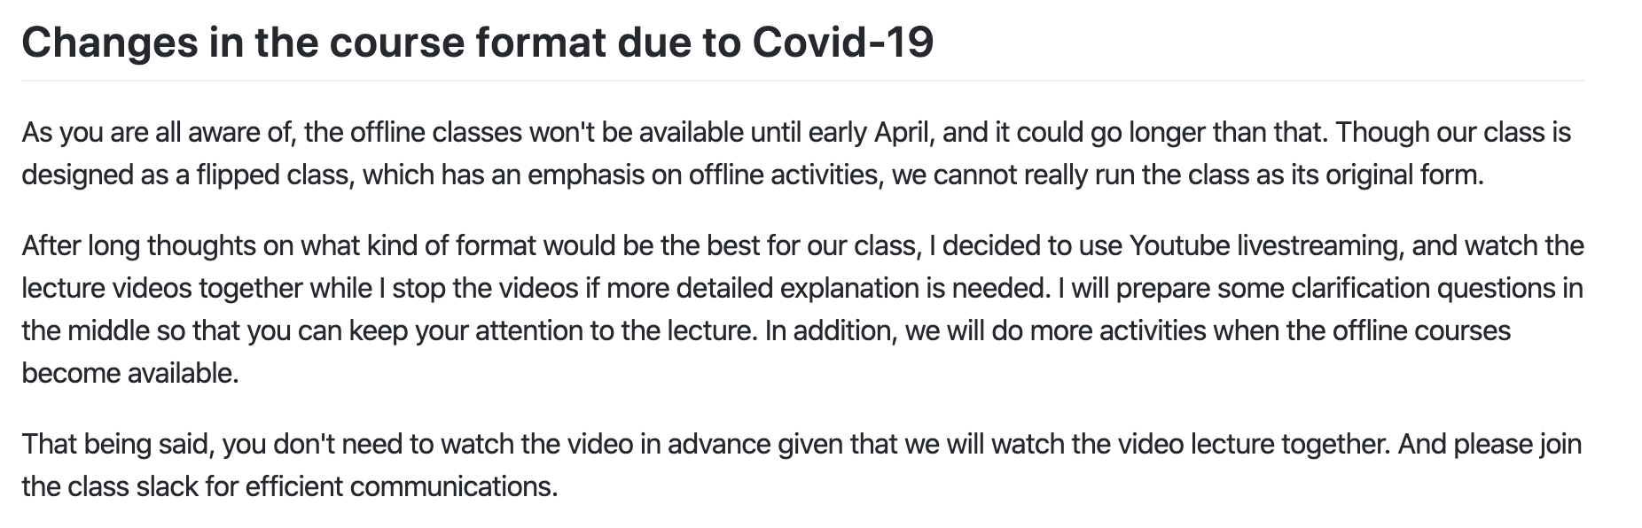
Lecture 01
CHOONG-WAN WOO | COCOAN lab | http://cocoanlab.github.io

Slide 13
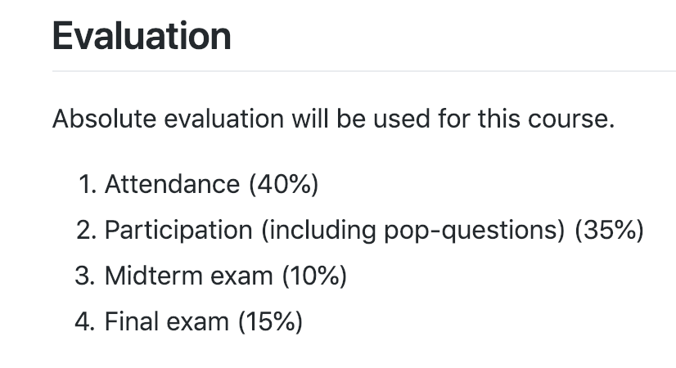
Lecture 01
https://github.com/wanirepo/Stats_2020Spring
For attendance,
I will give you pop-quizes during the livestreaming class using google forms
For each pop-quiz item, you will need to report your student ID and the google forms will record the time you answered
Later, I will count the student ID for each item for a specific period
CHOONG-WAN WOO | COCOAN lab | http://cocoanlab.github.io

Slide 14
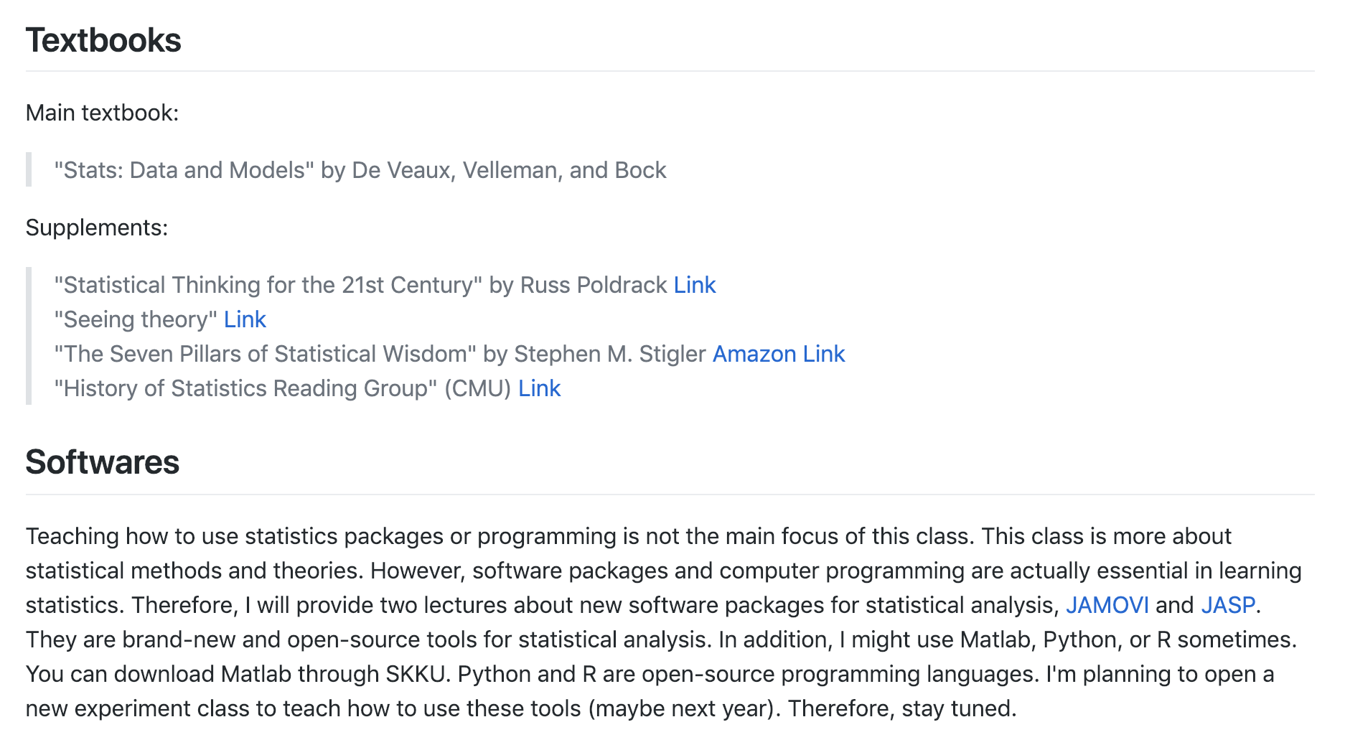
Lecture 01
https://github.com/wanirepo/Stats_2020Spring
CHOONG-WAN WOO | COCOAN lab | http://cocoanlab.github.io

Slide 15
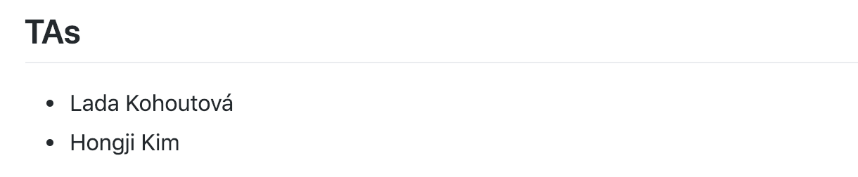

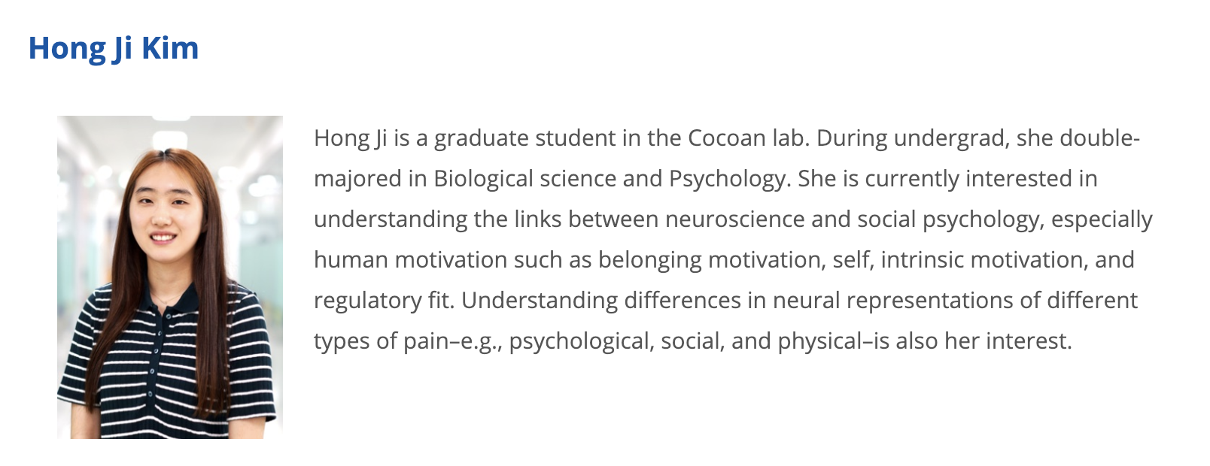
Lecture 01
https://github.com/wanirepo/Stats_2020Spring
CHOONG-WAN WOO | COCOAN lab | http://cocoanlab.github.io

Slide 16
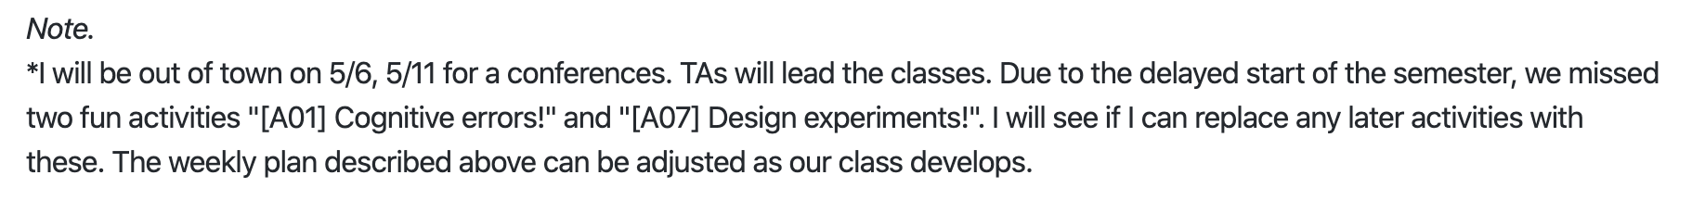
Lecture 01
https://github.com/wanirepo/Stats_2020Spring
But maybe not!! The conference is likely to be canceled.
CHOONG-WAN WOO | COCOAN lab | http://cocoanlab.github.io

Slide 17
Lecture 01
교수님 제가 깃 사용이 많이 안 익숙해 수업 자료를 다운받기가 너무 힘든데 혹시 수업 자료를 다운받을 다른 방법이 있을까요 ㅠㅠ
제가 수업계획서를 보고 수업자료를 다운받으려고 깃허브를 들어갔는데 처음 이용하다보니 이용방법을 잘 모르겠네요... command line을 어디에 입력해야하는지를 잘 모르겠습니다
Let’s see how to download the class materials…
CHOONG-WAN WOO | COCOAN lab | http://cocoanlab.github.io

Slide 18
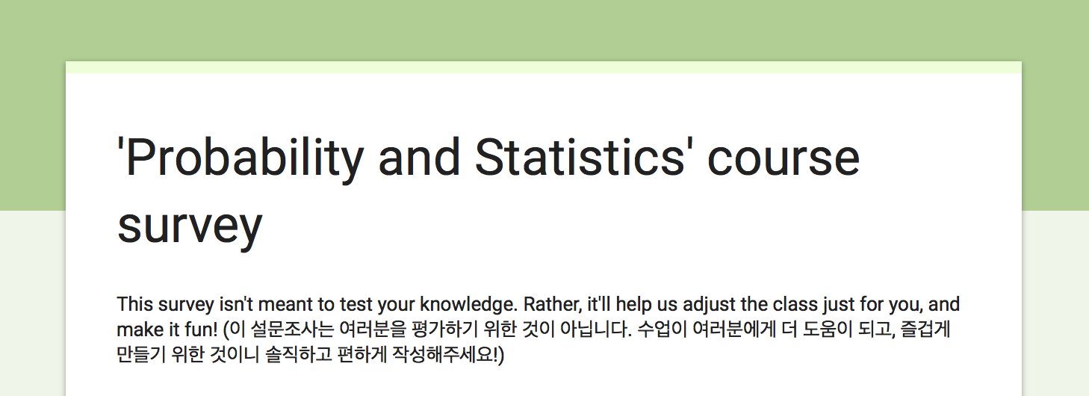
Lecture 01
Survey! (made by TAs)
Fill out the survey here!
https://forms.gle/5APqzTLnFJxXyR7h7
CHOONG-WAN WOO | COCOAN lab | http://cocoanlab.github.io

Slide 19
Lecture 01
To-do before the next class
Survey!
Sign up for slack
https://join.slack.com/t/wanistats2020/shared_invite/zt-cm4u3xsg-oRzbPWzrMRTmwr~eomLqFw
Download the textbook PDF!
https://acwang.files.wordpress.com/2015/08/stats-data-and-models-3rd-edition-richard-d-de-veaux.pdf
Next class: 3/18 Wednesday 12:00 PM
I will cover both “V02: Data visualization” and “V03: Comparing distribution”
It could be ~1.5 hours (I cannot really predict)
CHOONG-WAN WOO | COCOAN lab | http://cocoanlab.github.io

